Slide 1
Automation Testing
Chinta Ganesh

Slide 2
AGENDA
Introduction​ to Automation
​Frameworks
Project Structure
Sample Codes

Slide 3
Introduction
What is Automation Testing?
Automation Testing is the method of testing software products with special testing tools and frameworks to minimize human intervention and maximize quality.
What is Framework?
In any Real time project whenever Automation scripts are developed, One should come up with an Execution system called framework to run and maintain Automated tests

Slide 4
Locators & Syntax:-
Method | Syntax | Description
By ID | driver.findElement(By.id (<element ID>)) | Locates an element using the ID attribute
By name | driver.findElement(By.name (<element name>)) | Locates an element using the Name attribute
By class name | driver.findElement(By.className (<element class>)) | Locates an element using the Class attribute
By tag name | driver.findElement(By.tagName (<htmltagname>)) | Locates an element using the HTML tag
By link text | driver.findElement(By.linkText (<linktext>)) | Locates a link using link text
By partial link text | driver.findElement(By.partialLinkText (<linktext>)) | Locates a link using the link's partial text
By CSS | driver.findElement(By.cssSelector (<css selector>)) | Locates an element using the CSS selector
By XPath | driver.findElement(By.xpath (<xpath>)) | Locates an element using XPath query

Slide 5
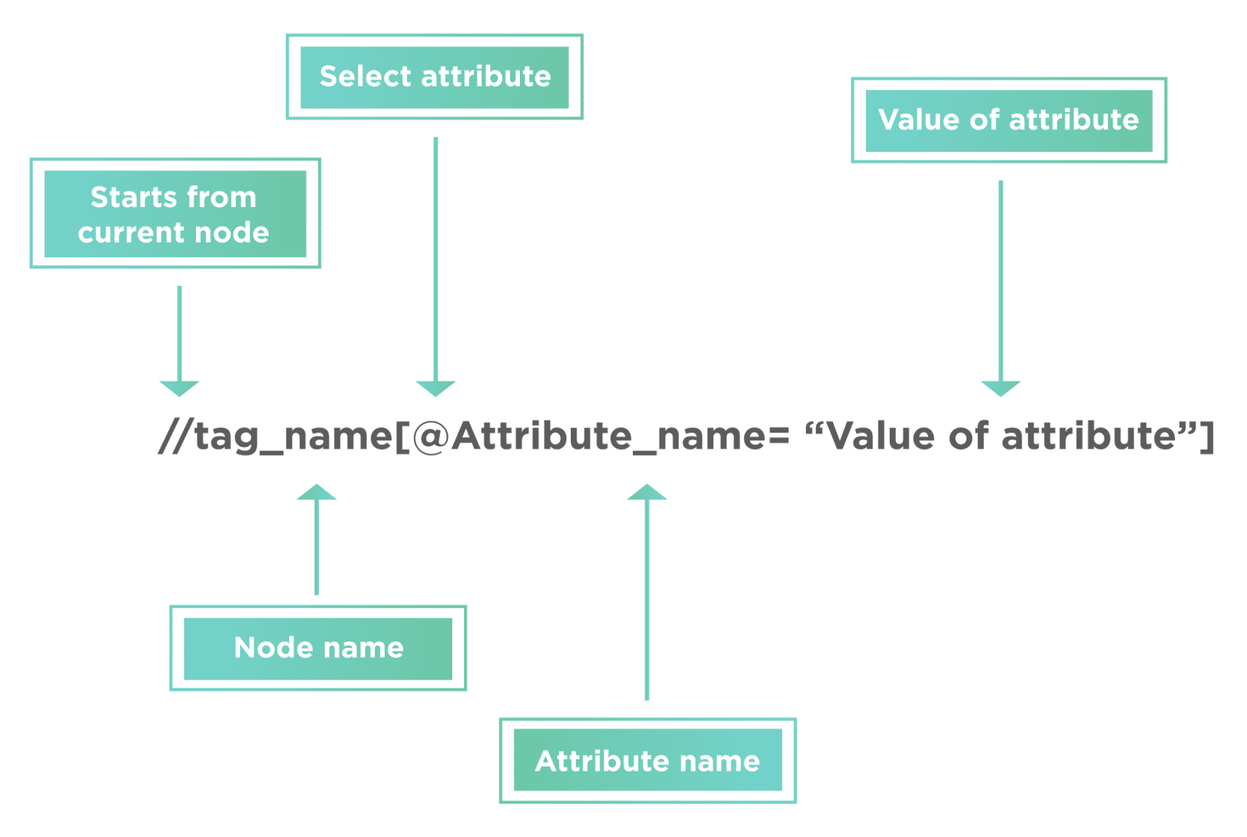
Xpaths:-
What is XPath?
XML Path or commonly known as XPath, is a query language for XML documents. It is made of path expression governed by some pre-defined conditions. Moreover, XPath can be effectively used to identify and locate almost any element present on a web page. It is quite helpful while working on a dynamic web page where the web element's unique attributes are not constant. Moreover, it allows us to write XML document navigation flow for locating web elements. Consequently, let's first understand what syntax does XPath uses to locate the web elements:
Syntax of XPath
XPath finds any element within a webpage by using DOM. So, its syntax is also made up of DOM attributes and tags, as shown below:
XPath = //tag_name[@Attribute_name = “Value of attribute”]
The XPath syntax generally starts with “//” double slash. That is to say, it will begin with the current node defined by the tag name.
The next part is tag_name; it denotes the HTML tag name of the node.
Subsequently, anything present inside the node encloses in the square brackets.
Additionally, the “@” sign selects the attribute.
Moreover, the “Attribute_name” is the name of the attribute of the node.
And, the “Value of attribute” denotes the attribute value from the node.
What is XPath?
XML Path or commonly known as XPath, is a query language for XML documents. It is made of path expression governed by some pre-defined conditions. Moreover, XPath can be effectively used to identify and locate almost any element present on a web page. It is quite helpful while working on a dynamic web page where the web element's unique attributes are not constant. Moreover, it allows us to write XML document navigation flow for locating web elements. Consequently, let's first understand what syntax does XPath uses to locate the web elements:
Syntax of XPath
XPath finds any element within a webpage by using DOM. So, its syntax is also made up of DOM attributes and tags, as shown below:
XPath = //tag_name[@Attribute_name = “Value of attribute”]

Slide 6
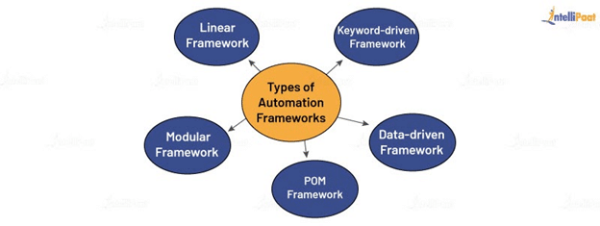
​Frameworks

Slide 7
Linear Framework
This is the simplest framework of all. Under this framework, you need to write a simple code to run the test cases without any modularity or sequential steps. It works as a record-and-playback model.
Keyword-driven Framework
It is a scripting technique where you associate keywords with certain actions, such as opening or closing of a browser, mouse-click events, and others. Later on, in your test scripts, you can call these keywords to perform a specific step. Also, you will have a file where you will maintain all the keywords, along with the actions they perform.
Data-driven Framework
In a data-driven framework, all the test case data inputs are stored in the table or in extension files, including .xls, .xml, .csv, etc. While executing the test scripts, it will read the values from the table. With the help of this framework, you can perform both positive and negative test cases.
Page Object Model Framework
In the POM framework, you will create an object repository for the web UI elements. It allows you to call these methods later on without having to write the code again. Thus, it results in less verbosity, code reusability, and reduced time-consumption to write test scripts.

Slide 8
Modular Framework
The modular framework allows you to divide the test scripts into small, independent modules. These modules will interact with each other in a hierarchical manner to run large test scripts. This will also help you create the required test scenarios and test the scripts individually.

Slide 9
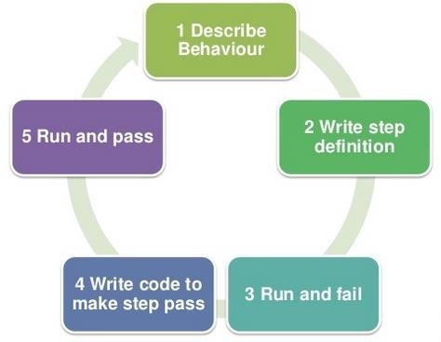
Cucumber framework

Slide 10
1.What is Cucumber?
Ans:- Cucumber is the BDD Framework for running automated tests. Cucumber does not Automate your testcases!
2.When my tests are already automated and can run, what cucumber does?
Ans:- Data driven, Parameterization, Execution controls, Hooks, Reports, Automation utilities and many more….
3.When you say automated tests, what type of Automation testcases does cucumber Support?
Ans:- Any Test (Web, Mobile, API, Unit Testing) which is written in Java/Ruby supported by Cucumber
4.How cucumber is unique and Best from other Test Frameworks (Keyword, Datadriven,Hybrid) in the Market?
Ans:- Because Testcases/Requirements are defined with on BDD methodology (Gherkin syntax)
No coding is required to implement Framework functionalities

Slide 11
The Cucumber Framework: BDD Framework for Selenium
Cucumber BDD framework mainly consists of three major parts – Feature File, Step Definitions, and the Test Runner File.
1. Feature File
A standalone unit or a single functionality (such as a login) for a project can be called a Feature. Each of these features will have scenarios that must be tested using Selenium integrated with Cucumber. A file that stores data about features, their descriptions, and the scenarios to be tested is called a Feature File.
Cucumber tests are written in these Feature Files that are stored with the extension – “.feature”. A Feature File can be given a description to make the documentation more legible.
Example:
The Login function on a website
Feature File Name: userLogin.feature
Description: The user shall be able to login upon entering the correct username and password in the correct fields. The user should be directed to the homepage if the username and password entered are correct.
Keywords such as GIVEN, WHEN, and THEN used to write the test in Cucumber are called Annotations.
GIVEN user navigates to login page by opening Firefox
WHEN user enters correct <username> AND <password> values
THEN user is directed to the homepage

Slide 12
2. Step Definitions
Now that the features are written in the feature files, the code for the related scenario has to be run. To know which batch of code needs to be run for a given scenario, Steps Definitions come into the picture. A Steps Definitions file stores the mapping data between each step of a scenario defined in the feature file and the code to be executed.
Step Definitions can use both Java and Selenium commands for the Java functions written to map a feature file to the code.
Example:
package StepDefinition;
import cucumber.api.java.en.Given;
import cucumber.api.java.en.Then;
import cucumber.api.java.en.When;
public class Steps {
@Given("^user navigates to the login page by opening Firefox$") //Code to Open Firefox Browser and launch the login page of application to define the GIVEN step of the feature
@When("^user enters correct username and password values$") //take inputs for username and password fields using find element by xpath. Put the correct username and password values as inputs to define the WHEN step of the feature
@Then (“^user gets directed to homepage$”) //Direct to the Homepage of the application as a result of correct username and password inputs in the WHEN step. This would define the THEN step of the feature

Slide 13
3. Test Runner File
To run the test, one needs a Test Runner File, which is a JUnit Test Runner Class containing the Step Definition location and the other primary metadata required to run the test.
The Test Runner File uses the @RunWith() Annotation from JUnit for executing tests. It also uses the @CucumberOptions Annotation to define the location of feature files, step definitions, reporting integrations, etc.
Example:
Test Runner Class in cucumberTest package, with the feature files in “src/test/Feature” location and Step Definition files in “src/main/stepDefinition” folder.
package cucumberTest;
import org.junit.runner.RunWith;
import cucumber.api.CucumberOptions;
import cucumber.api.junit.Cucumber;
@RunWith(Cucumber.class) @CucumberOptions( features = "src/test/Feature" ,glue={"src/main/stepDefinition"} ) public class TestRunner { }

Slide 14
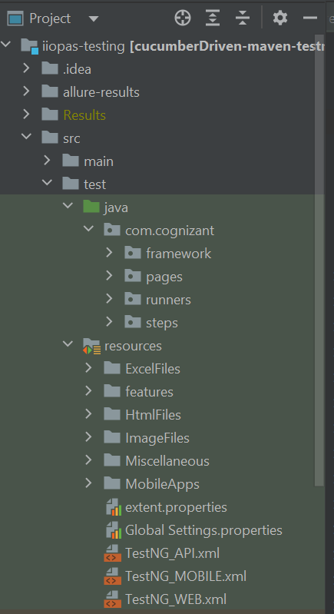
Project Structure
Here initially we need to create two major folders called Java and resources
In Java we need to store all our java classes i.e page classes, step classes, runners classes and frameworks which was written in java
In resources folder we need to store all the resources like Excel files, feature files, images etc.

Slide 15
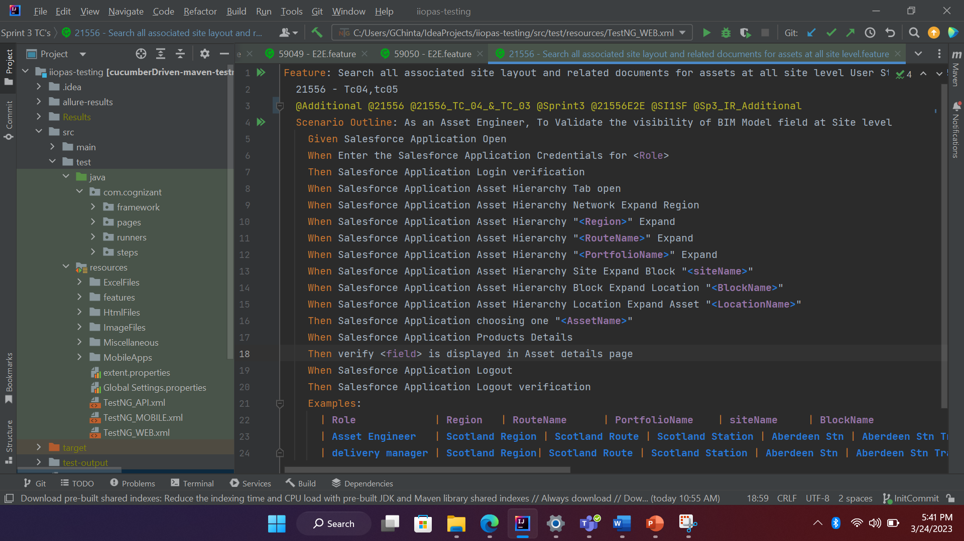
Sample Codes
Feature | Description
Scenario | Simple scenario
Scenario Outline | Requires user to provide test data in the “Examples” section
Data Tables | Requires user to provide test data for test step
Scenario Context | Sharing of values between test steps
Cucumber Data Types | Data types handled by cucumber
Cucumber Regular Expression | Usage of regular expression in cucumber scenarios
Cucumber hooks | Executes additional code in test scenarios
Here it is an Example of feature file which should be extension with .feature
In this we will use gherkin language for better readability and understanding

Slide 16
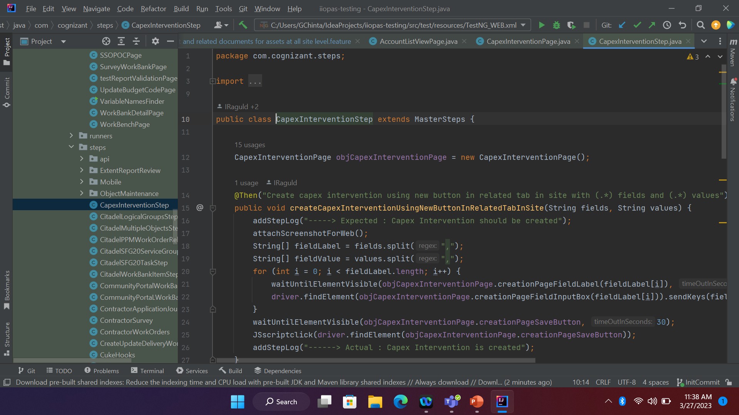
Step class Example:-

Slide 17
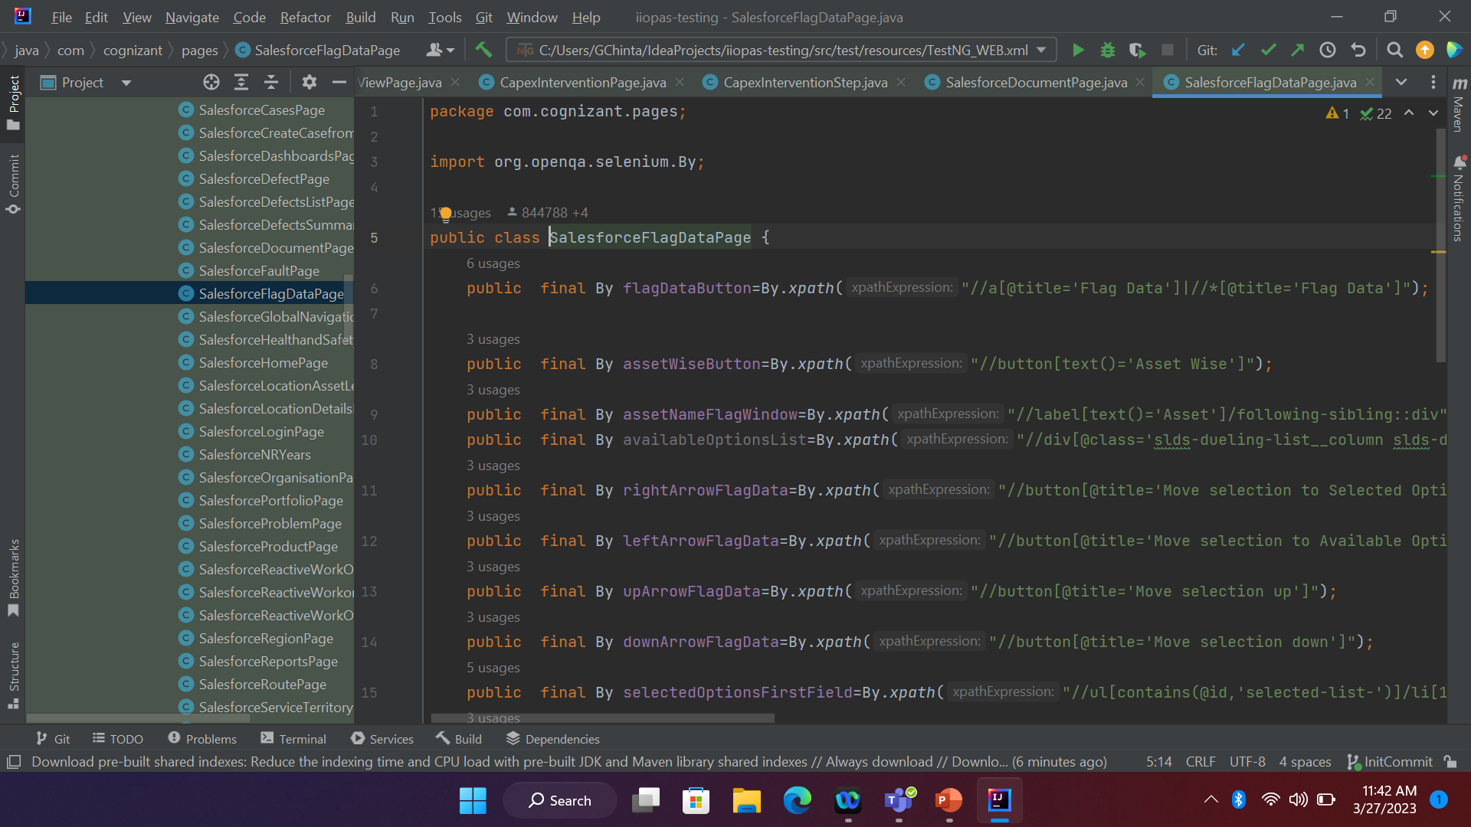
Page class Example :-

Slide 18
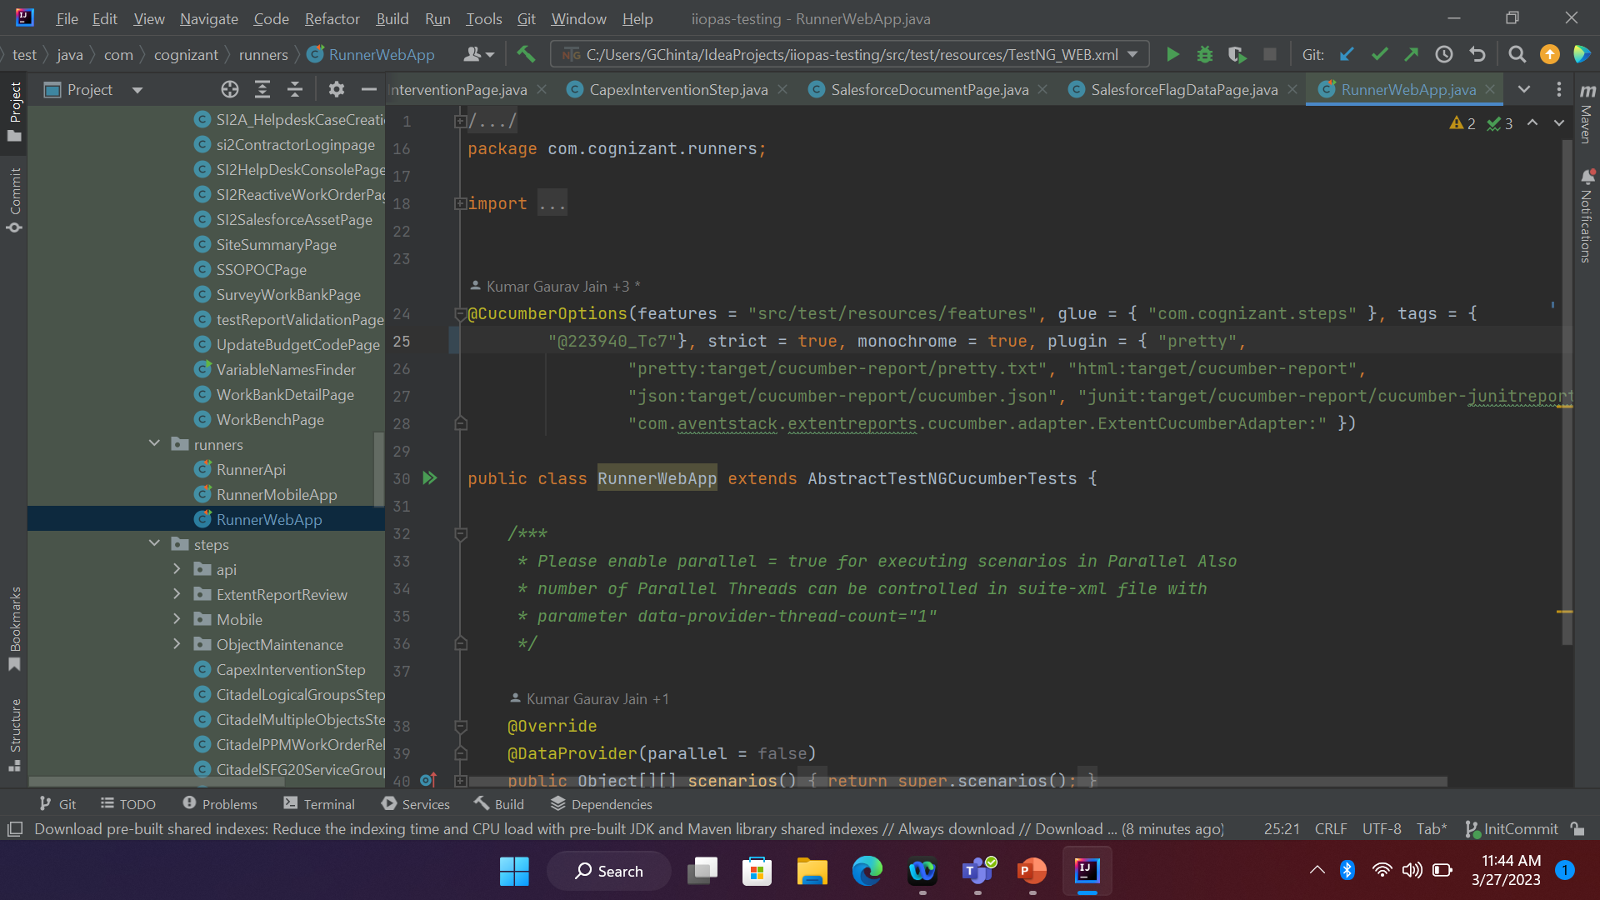
Test Runner class Example :-

Slide 19
THANK YOU
Chinta Ganesh
Chinta.ganesh@cognizant.com

